Slide 1
The Global New Left
(1) Outline the conditions of the “Great Boom” from 1950-1980
(2) Lay the foundations for understanding why massive protest broke out worldwide in the late 1970s despite seeming economic prosperity
(3) Explore some of the protests and their social, cultural, and political ramifications

Slide 2
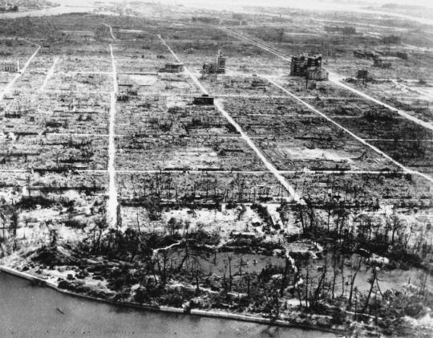
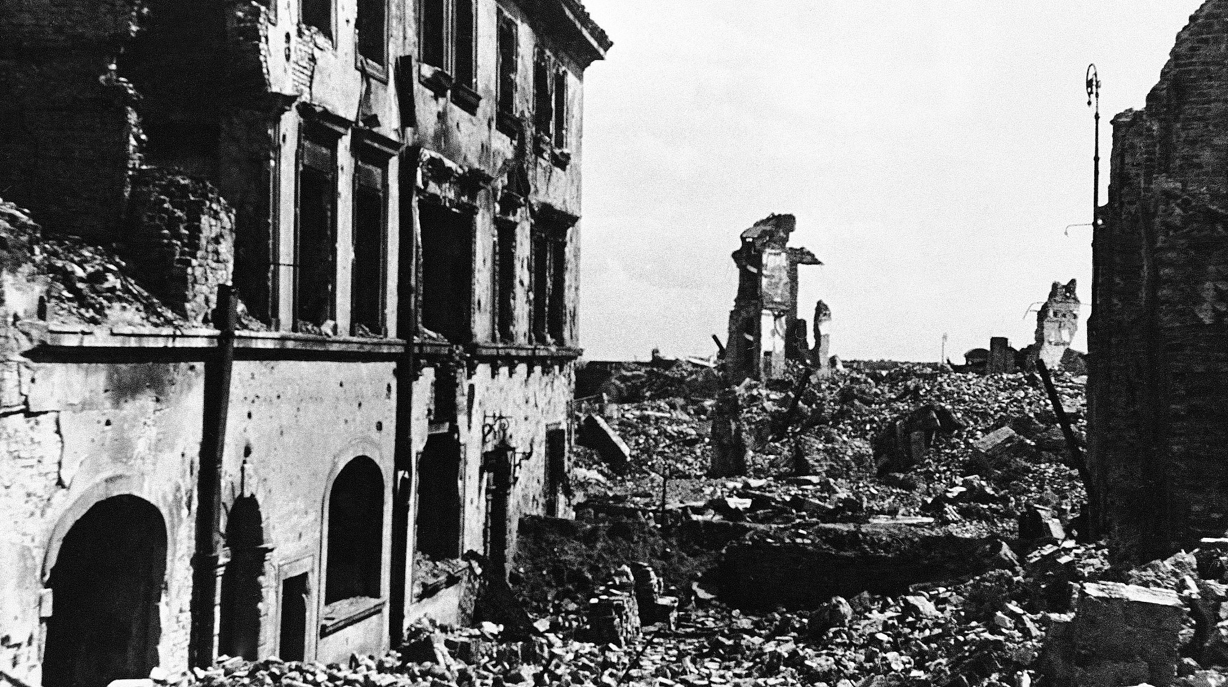
War-Torn Europe and Japan

Slide 3
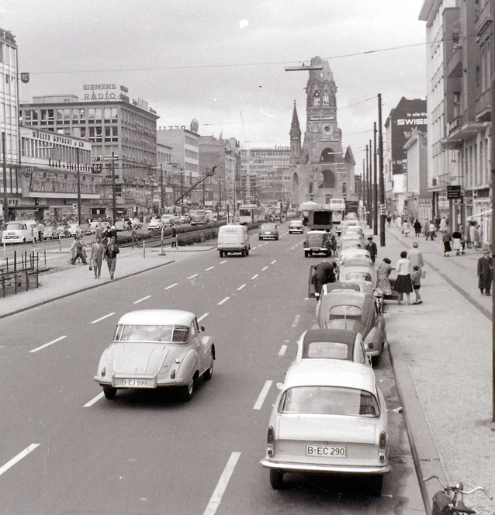
The Great Boom
Marshall Plan funneled US capital into Japan and Europe, for political reasons as part of the Cold War
German Economic Miracle-
industrial production grew by 25 percent in 1950 and 18.1 percent in 1951
By 1960 surpassed level of production achieved by the Nazis
Japanese Economic Miracle- 1965 GDP $91 billion, 1980 GDP, $1 trillion
NICs- Industrialization spread even to the Third World, the so-called “newly industrialized countries” from the 1970s on

Slide 4
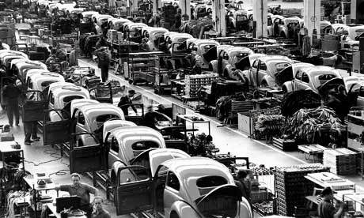

Why the Boom?
Fordist technique spreads to Europe and Japan
Fordist technique spreads to other industries
Research and Development
Capital intensive growth
Advantage of wartime destruction or backwardness
Success of Bretton Woods and the UN

Slide 5

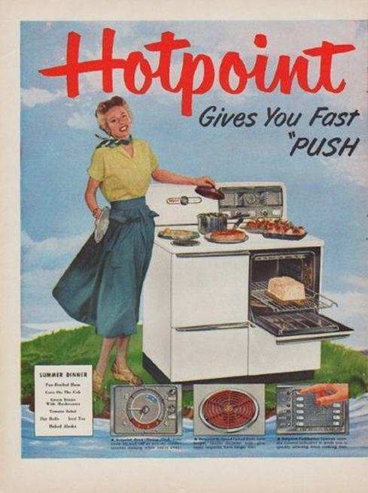
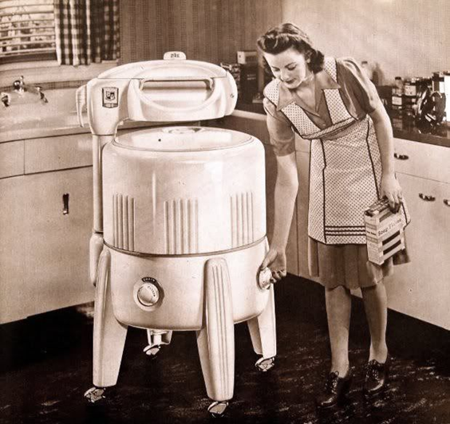
Affluent Society
The idea that material abundance could spread indefinitely, ending historic problem of scarcity
Wrapped up in politics of demand subsidization and macroeconomic control

Slide 6
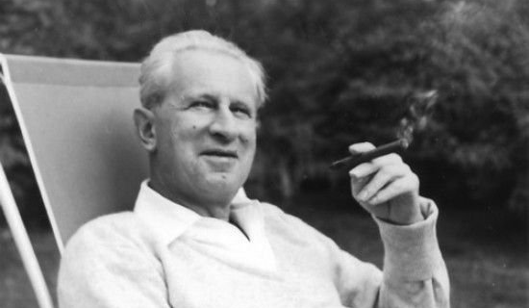
1950s Left Intelligentsia
Western Marxism focused on issues of alienation, cultural degradation of consumer society
Basically accepted “affluent society thesis” for advanced industrialized countries but questioned its moral foundations
Affluence depends on exploitation of minorities and women domestically, and on Third World internationally
Housed in academia, not political parties

Slide 7


The Roots of Radical Feminism
Baby boom and suburbanization reinforced ideas of domesticity
Transnational intellectuals developed concepts of gender
Women joined white collar workforce
Expansion of college education include

Slide 8
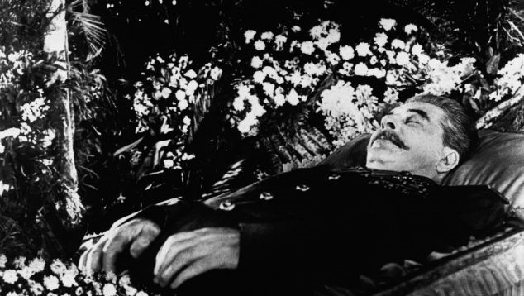
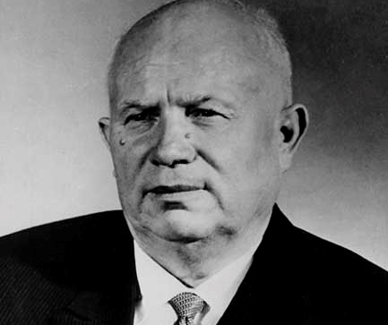
Destalinization
Stalin’s death in 1953 left a power vacuum
Nikita Khrushchev delivered “secret speech” 1956
“Destalinization” motivated liberal reformism in Soviet-controlled Eastern European states
Communism lost moral high ground in much of the world

Slide 9
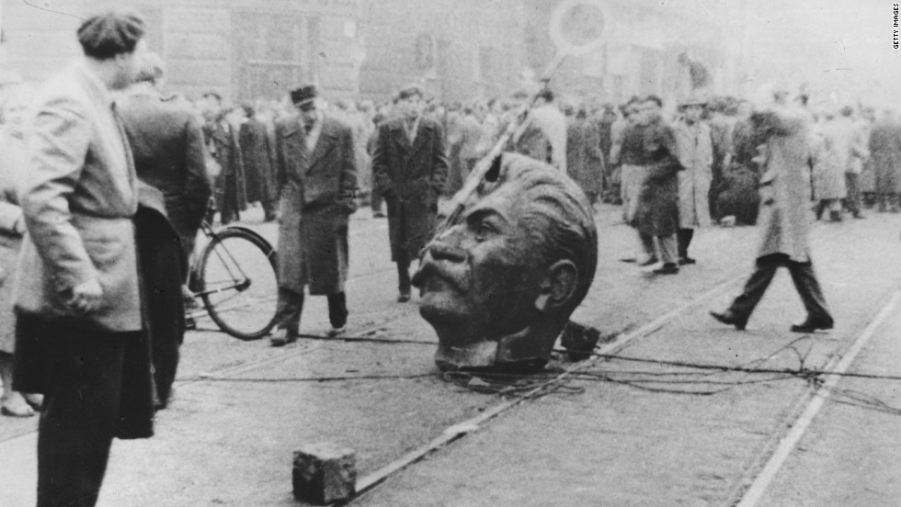
Hungarian Revolution, 1956
Student protest led to mass nationwide revolt
Soviet Union crushed the revolution
Buttressed Cold War claims about Soviet authoritarianism
Pushed youth and European left into Western Marxist camp

Slide 10
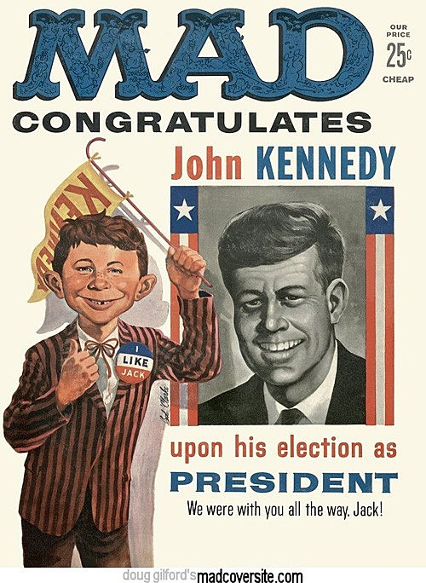
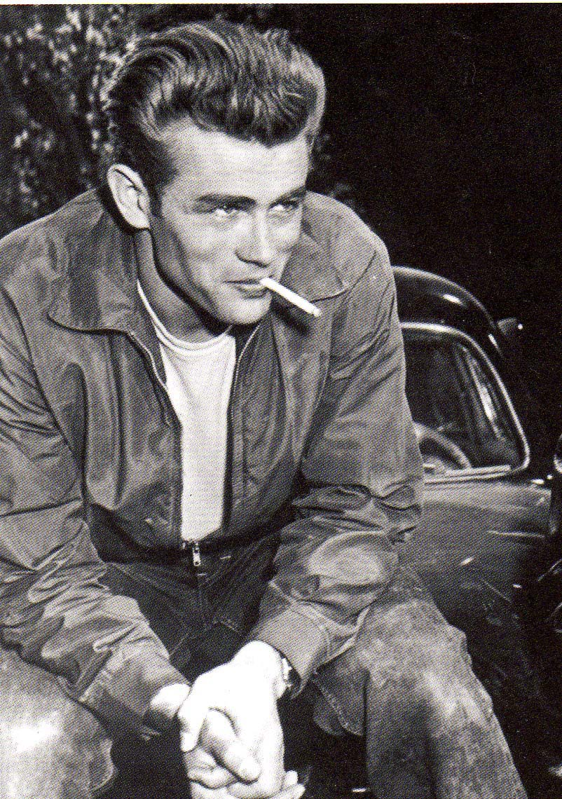
Late 1950s Youth Culture
In college in record numbers
Tired of the Cold War
Irreverent icons
Ambivalent about consumer culture

Slide 11
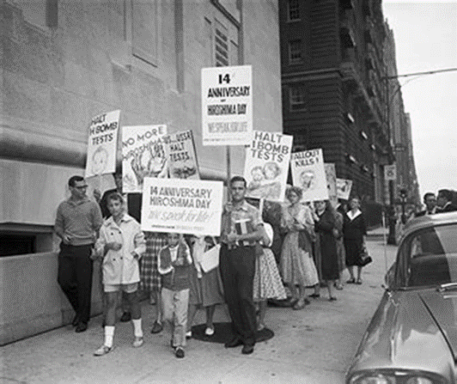
SANE
Students were especially opposed to nuclear proliferation

Slide 12
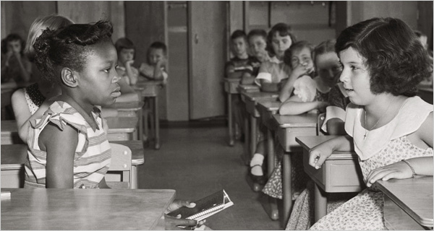
Brown v. Board 1954
NAACP since early 1940s had pursued aggressive legal strategy to challenge Jim Crow
Class action suit challenged segregated public schools in Topeka, Kansas in 1951
Composition of the Supreme Court had changed under 12 years of FDR and 8 years of Truman
Effectively overturned Plessy v. Ferguson

Slide 13
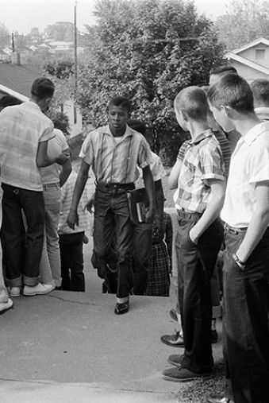
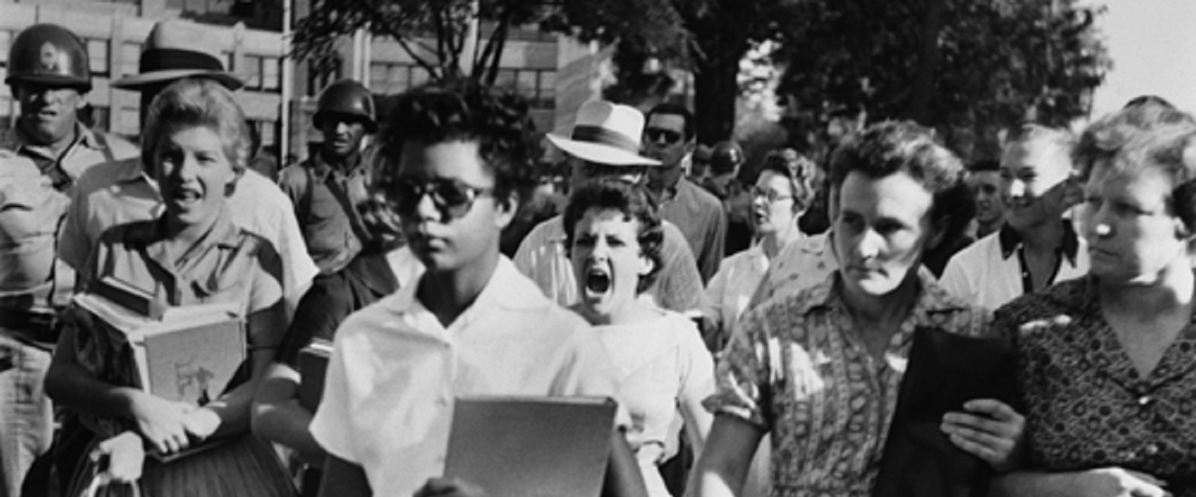
Desegregation was Contentious and Televised

Slide 14
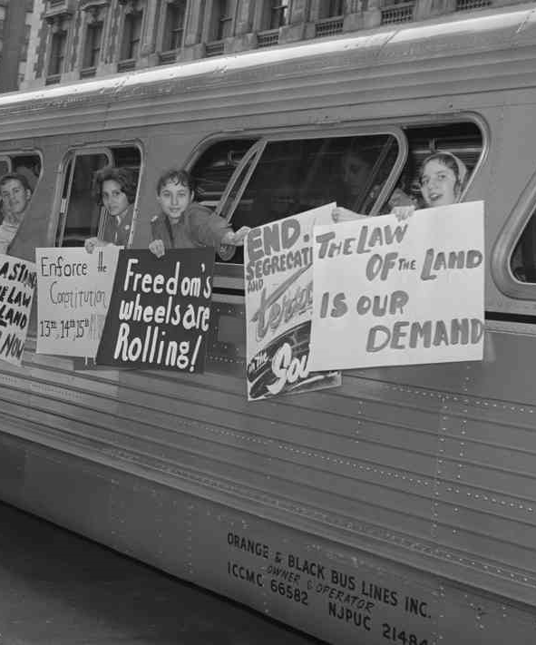
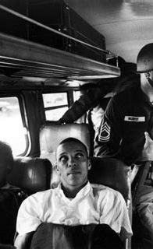
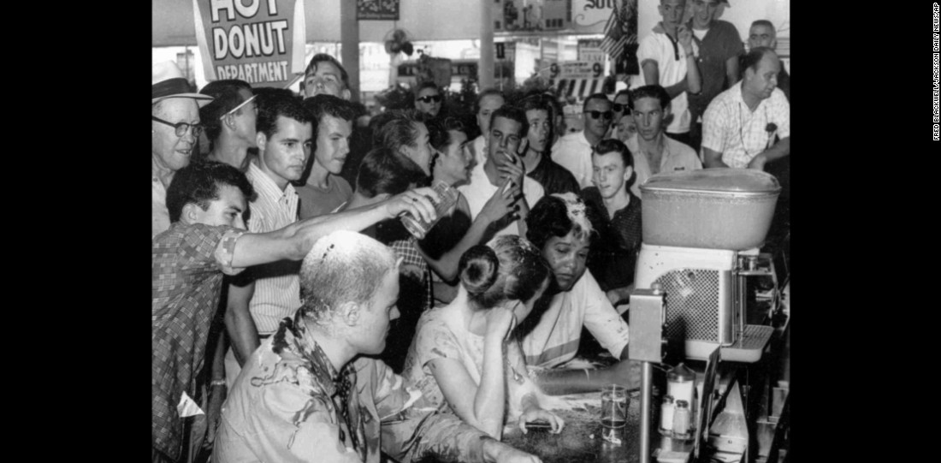
Direct Action
Roots in anarchist, IWW, and feminist protest tactics, often employed by people deprived of political voice
Long intellectual roots, most immediately Gandhi
Made deliberate use of television
Sit-ins, 1955-1962, challenged segregation of private businesses
Freedom rides 1961 challenged non-enforcement of Supreme Court desegregation of interstate public transit

Slide 15
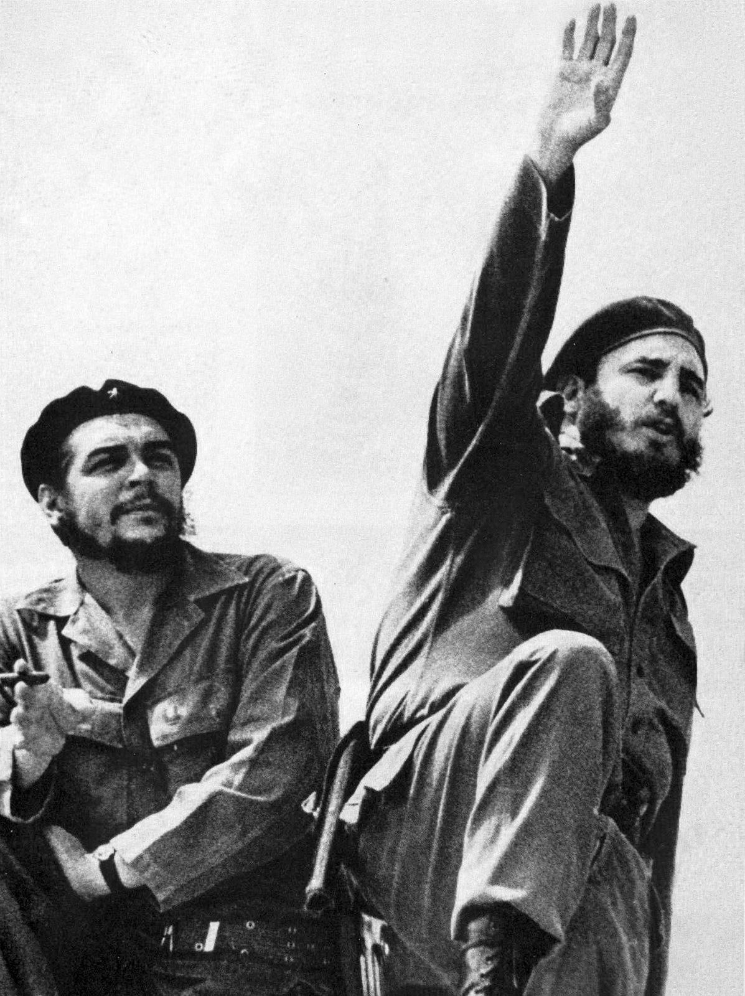
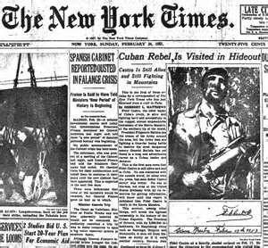
Cuban Revolution
Transnationally, Cuban Revolution most important symbolic moment for New Left Third Worldism
Supported by academic left intelligentsia: Sartre, C. Wright Mills, Paul Sweezy, Ernest Mandel
Elevated Latin American intellectual left
Gained a cult following among college youth

Slide 16
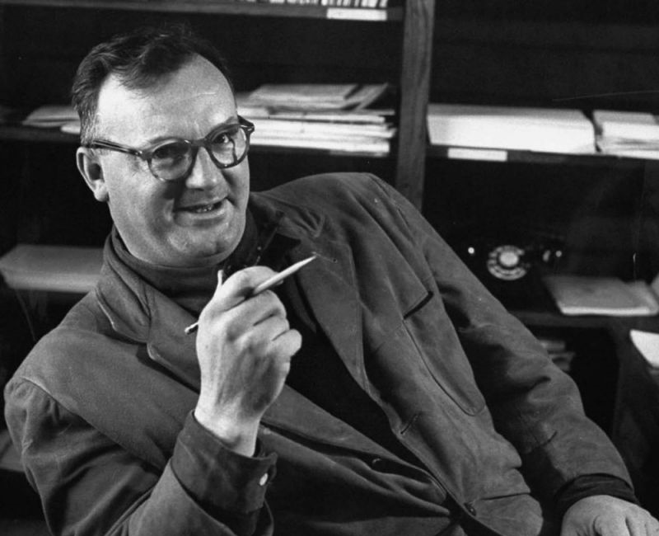
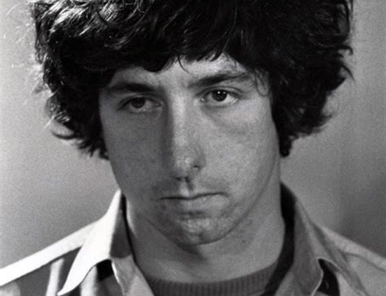
Student New Left
European students rejected “Old Left” (Communism) in favor of academic Marxism
1962 “Port Huron Statement” opening manifesto of Students for a Democratic Society
German Student Movement took off after 1966, motivated by opposition to Vietnam
Chilean students became extremely radical in the 1960s
Internationally, imperialism and solidarity with the Third World was the common thread

Slide 17
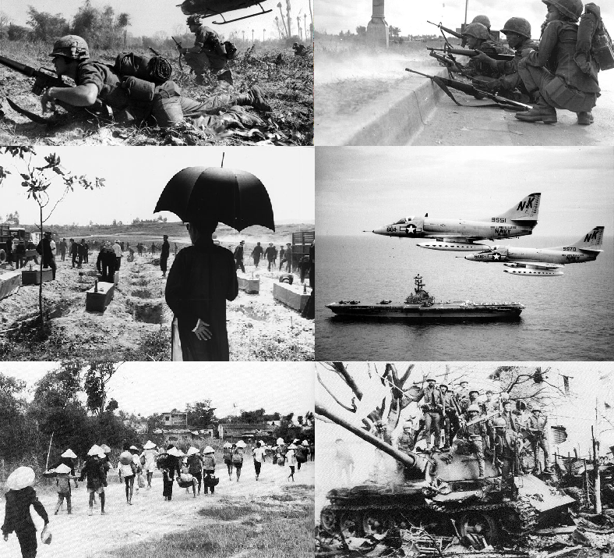
Vietnam War
US had supported French occupation of Indochina throughout the 1950s
Kennedy escalated presence of US advisory troops
In 1964 became an occupying force waging a counterinsurgency against local guerillas
Justified by “modernization theory,” including advisory capacity of WW Rostow

Slide 18
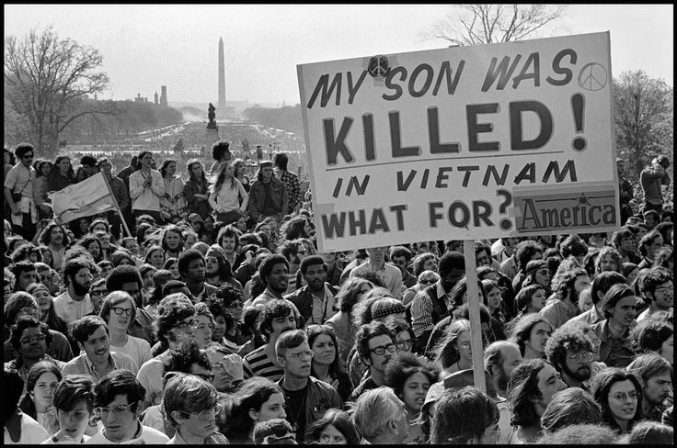
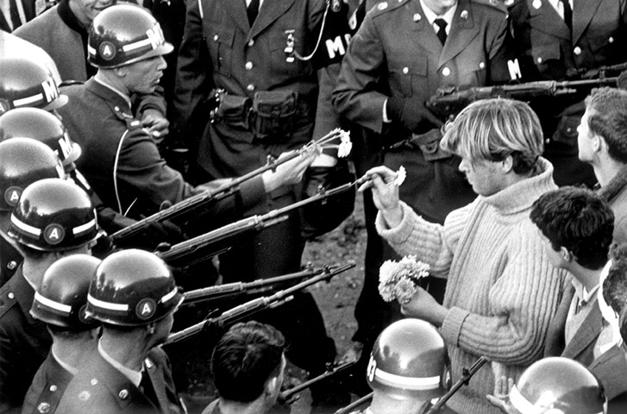
March Against the War, 1965

Slide 19
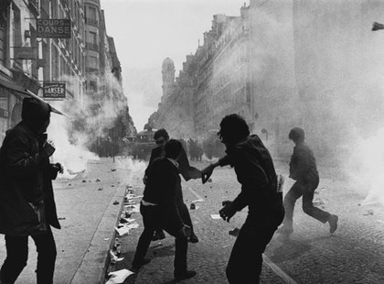
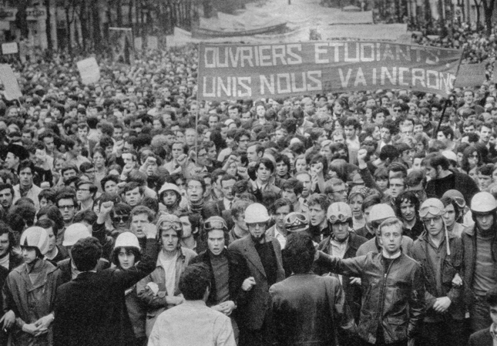
Paris, 1968
Student New Left took to the streets in May to protest
Workers quickly joined in with a mass strike
Prime Minister de Gaulle briefly fled, leaving the country in a power vacuum
Momentum fizzled in June and July, leading to restoration
Still considered a cultural turning point for the country, and spurred similar outbursts worldwide

Slide 20
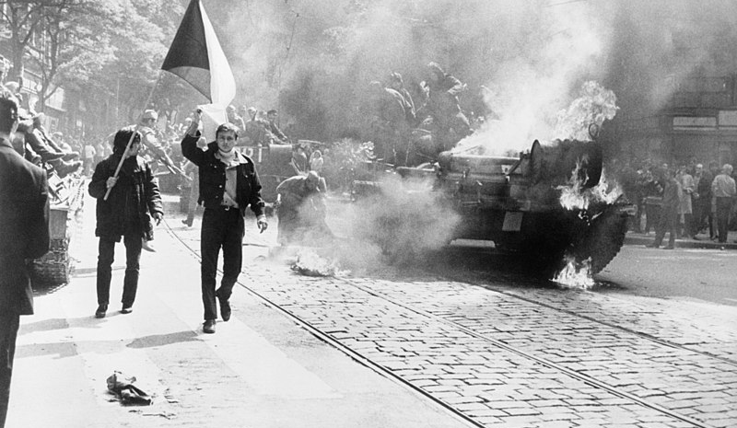
Prague Spring, 1968
Soviet-controlled Czechoslovakia initiated liberal reform movement
Preceded by suppression of Western-oriented intellectuals
Many parallels with the goals and criticisms coming from the Western New Left
Soviet invasion and repression spurred sympathy protests

Slide 21
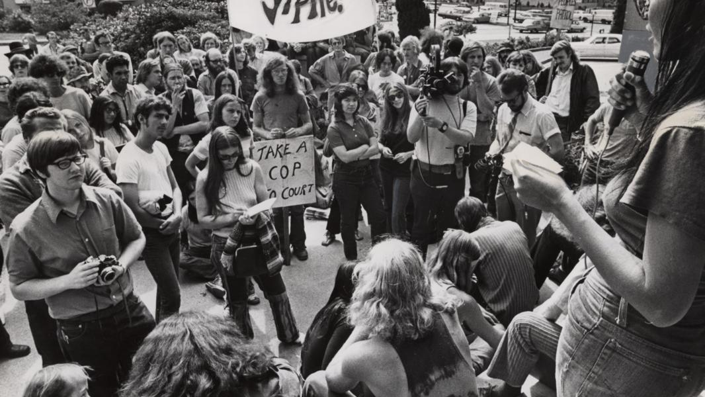

Yippies and Hippy Culture
Counterculture merges with anti-war movement
Leaders Abbie Hoffman and Jerry Rubin staged public acts of buffoonery, called “guerrilla theater”
Conflict with SDS, which wanted more serious organization

Slide 22
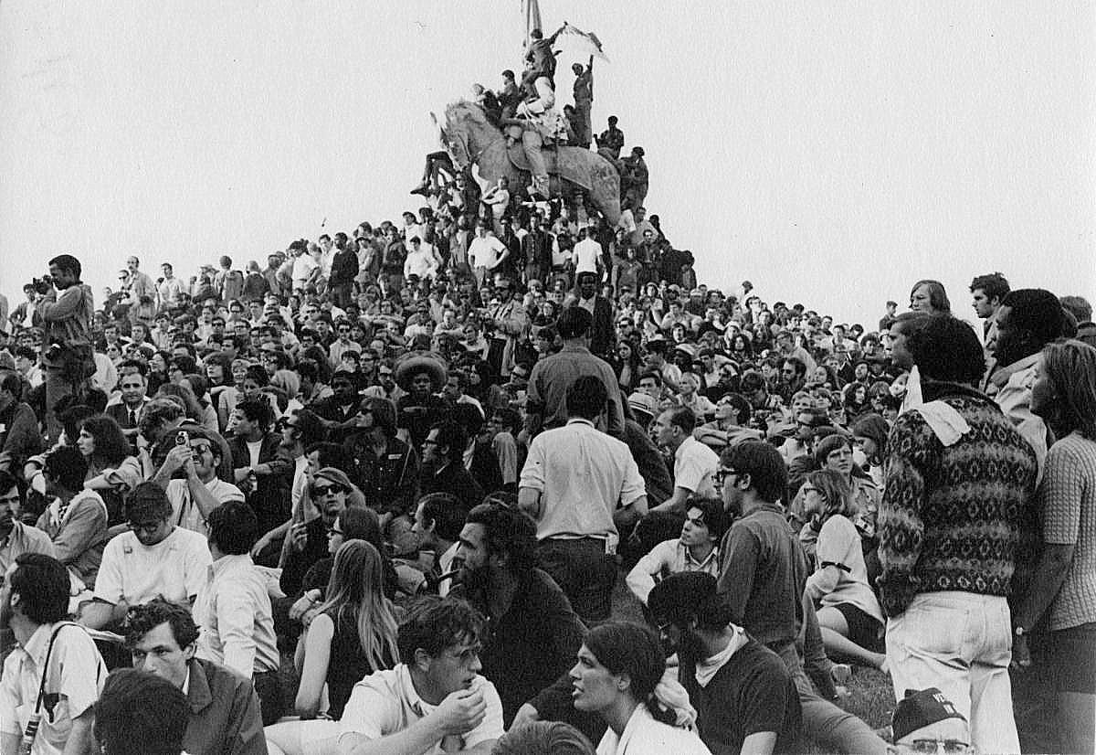
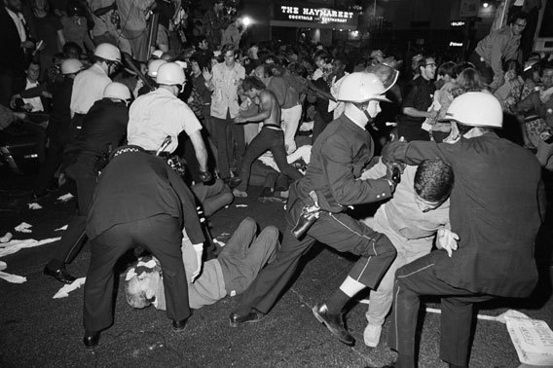
1968 Democratic National Convention
10,000 protesters showed up in Chicago
Mayor Daley deployed National Guardsmen
Radicalized students emulated Third World guerrilla tactics planned to fight it out
Public largely unsympathetic to youths

Slide 23
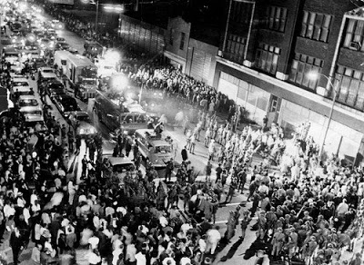
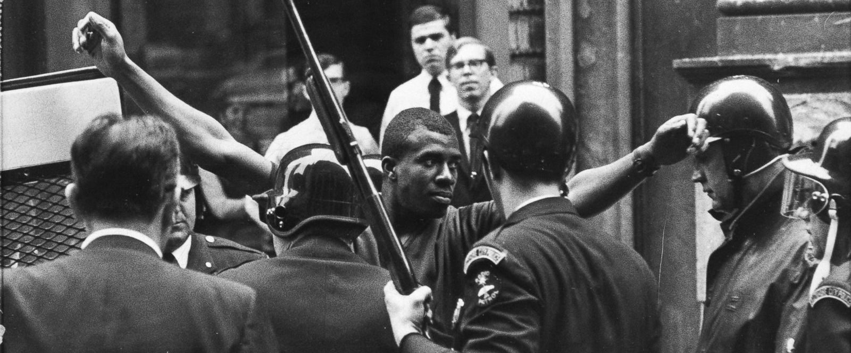
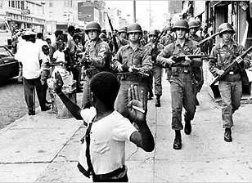
Riots Following King Assassination, 1968

Slide 24
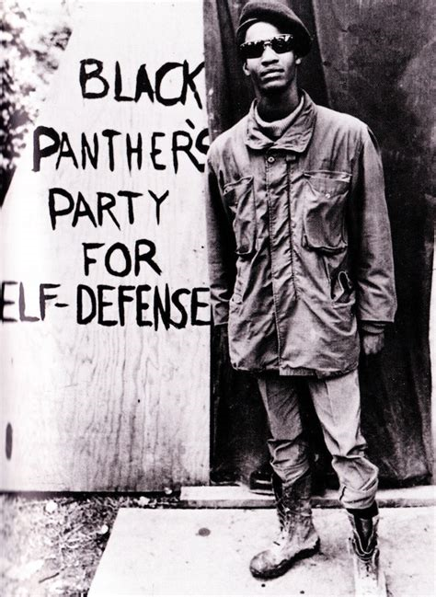
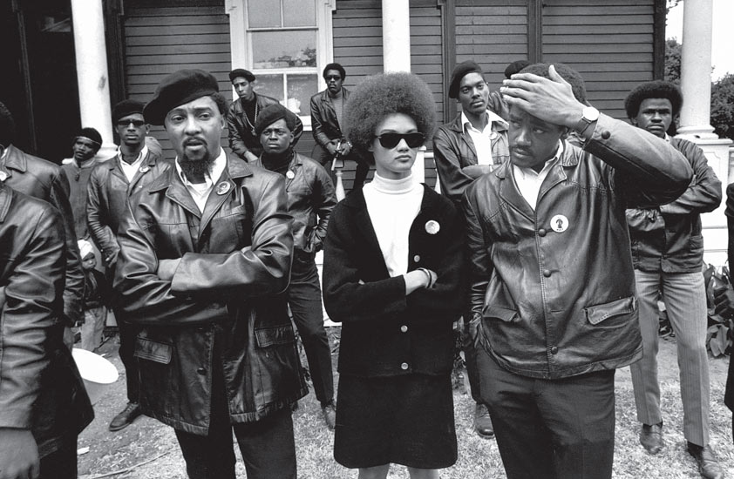
Black Power
Many black activists abandoned non-violent resistance in favor of armed resistance
Black Panther Party formed in Oakland under Bobby Seale and Huey Newton in 1966
Spread throughout the US and the world

Slide 25
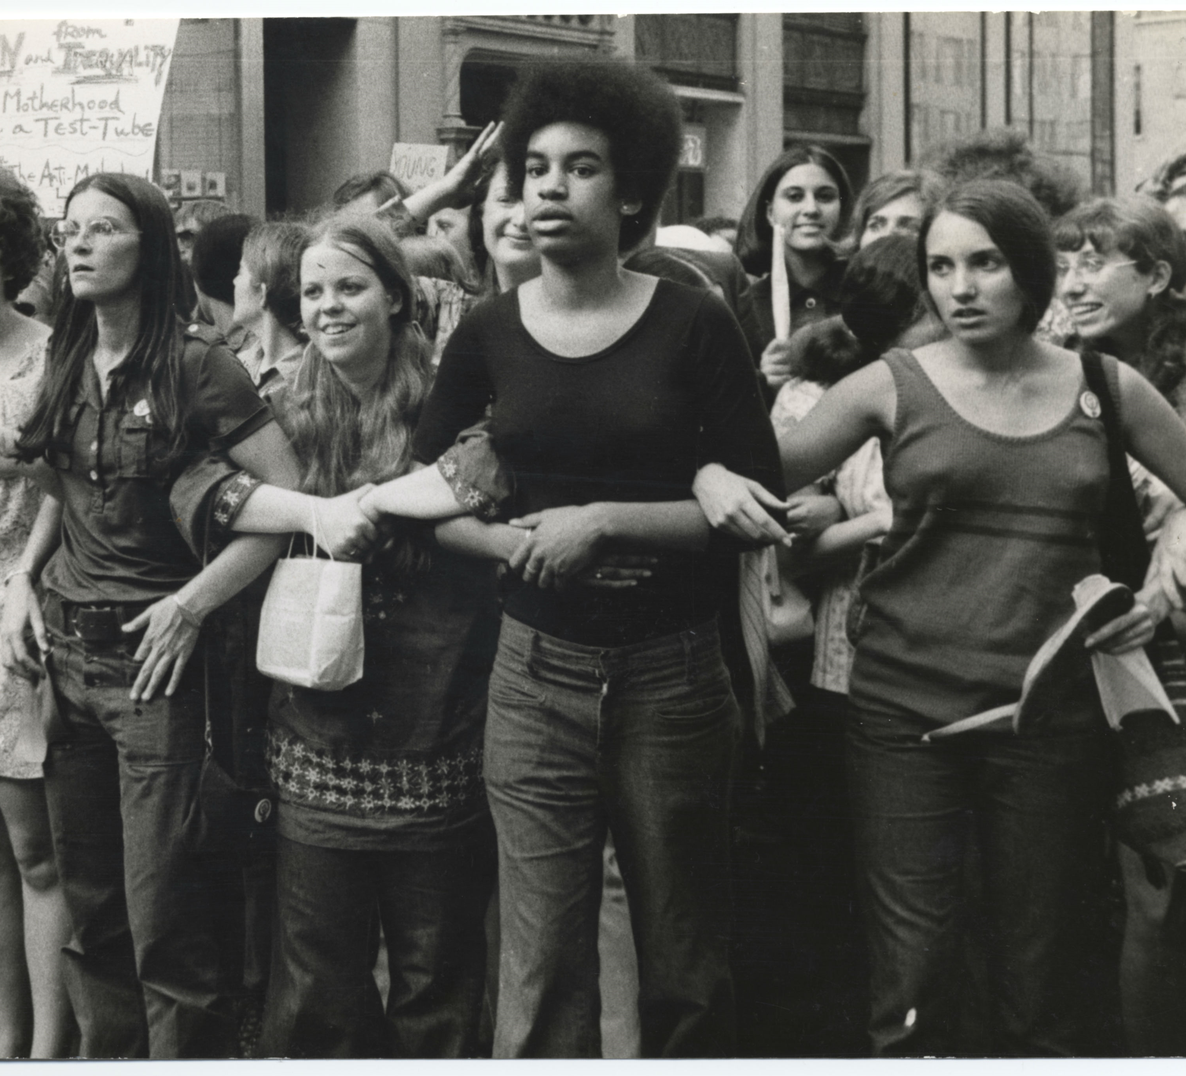
Radical Feminism
Shift from suffrage to smashing all forms of patriarchy
Emerged out of New Left and Black Power organizations, where women activists were frustrated by their subordinate roles

Slide 26
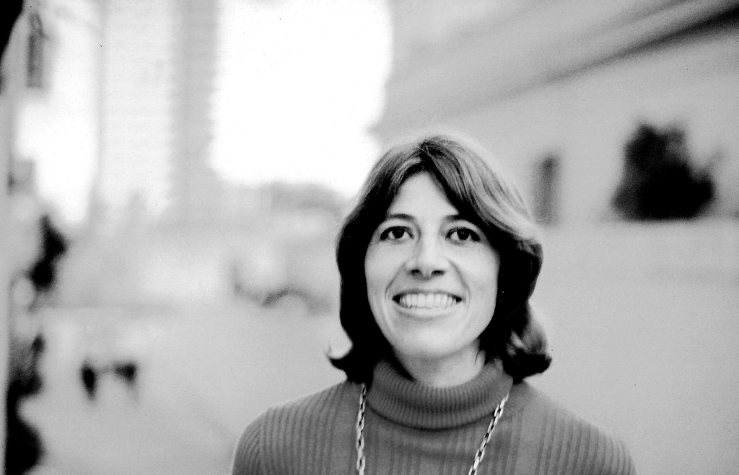
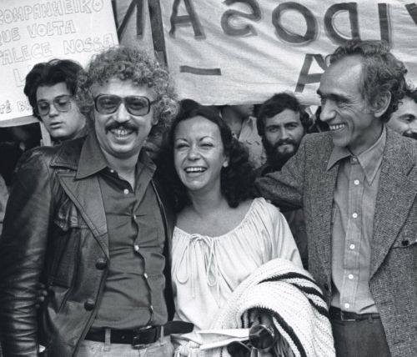
Latin American Marxist Intelligentsia
Cohered around “dependency theory” in mid-1960s
Rejected Western Marxism in favor structuralism and Leninism
Congregated at the University of Santiago from 1966-1973
Foundation for 1970s World-Systems Theory

Slide 27
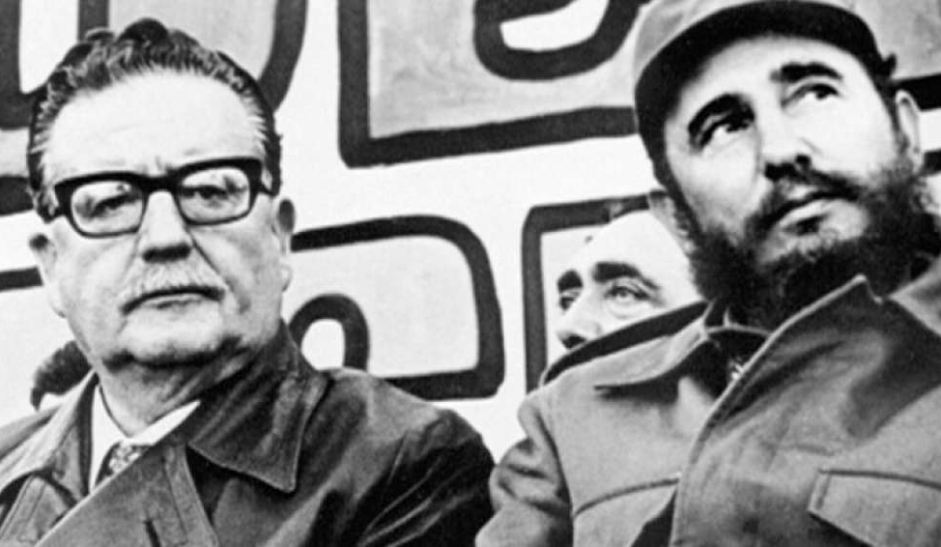
Allende Administration
1970 self-described Marxist Salvador Allende elected President of Chile
Strong support from students and academic Marxists
Policies not much different from other Third World leaders
But included nationalization of US-controlled copper mines

Slide 28
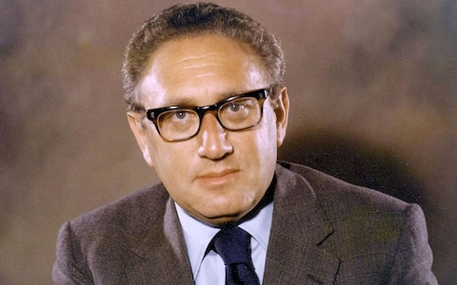
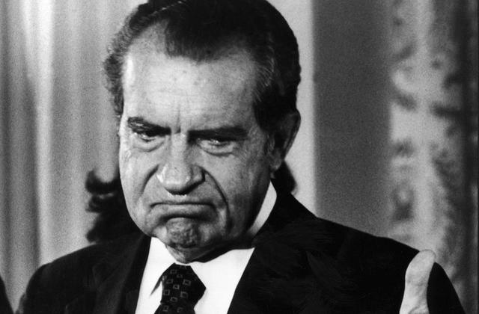
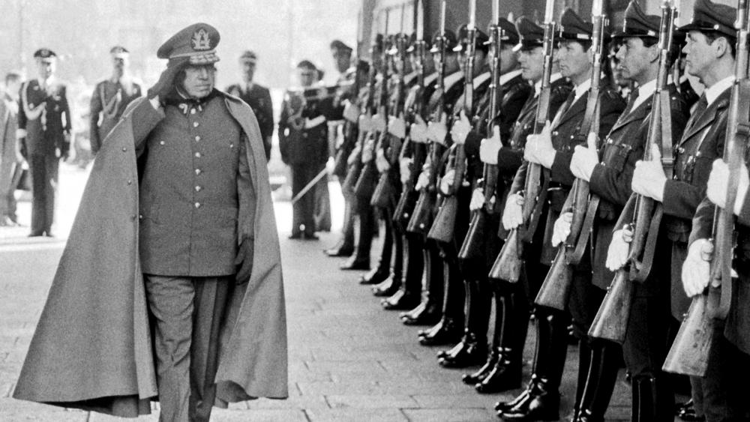
Coup
Track I- Nixon, Kissinger, and the CIA worked to destabilize Allende’s regime
Track II- Identify a figure in the military willing to overthrow Allende by force
Augusto Pinochet executed the coup, September 11, 1973
Brought in “Chicago Boys” to implement policies that would come to be known as neoliberalism

Slide 29
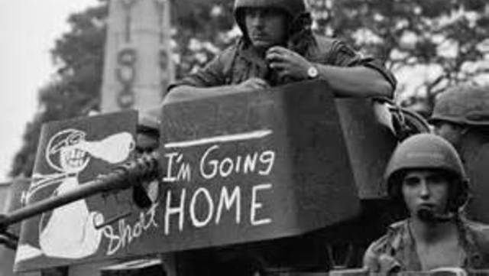
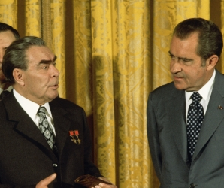
Restoring Order
The US and the USSR turned to détente to get their own respective houses in order
The US finally pulled out of Vietnam, taking away a major impetus for student radicalization
Conservative movement kicked in to counter radical discourse
Left movements fractured, radicalized, dissipated, then became entrenched in academic life

Slide 30
Consequences:
From that time to the present “the left” has been housed primarily in the university
Vietnam syndrome soured the US on modernization theory at least until the Iraq War
The Cold War passed its cusp, and began a steady if bumpy dissent
Social antagonism shifted to the cultural front, especially in advanced industrial economies

